Slide 1

Detecting Compromised AWS Accounts via Anomalous API Calls
School of Computer Science and Engineering
Department of Computer Science and Engineering
Submitted By:
Reetikesh Choudhury
23FE10CSE00642
Supervised By:
Ms. Vaishali Chauhan

Slide 2

Objectives
To analyze AWS CloudTrail logs and extract behavioral features.
To apply machine learning algorithms for anomaly detection.
To identify deviations in API call patterns indicative of account compromise.
To evaluate the performance using metrics such as score distribution comparison, PCA, Disagreement penalty and Temporal smoothing

Slide 3

Introduction
Cloud computing underpins modern digital infrastructure, with Amazon Web Services (AWS) leading as a key provider.
API calls made by compromised accounts often deviate from normal behavior these anomalies can reveal potential breaches.

Slide 4
Introduction
Traditional security mechanisms may fail to detect subtle or evolving attack patterns.
Hence, detecting anomalies in API usage patterns offers a proactive and intelligent defense mechanism.
This project focuses on machine learning based anomaly detection on AWS CloudTrail logs to identify compromised account behavior.

Slide 5

Literature Review
Overview of Existing Work
Previous research focused on conventional system architectures and control mechanisms that often faced issues with scalability, data reliability, and energy efficiency.
Most prior methods relied on static configurations or rule-based automation with limited adaptability to changing operational contexts.
Traditional rule-based systems fail against adaptive or stealthy attackers.

Slide 6
Literature Review
Overview of Existing Work
Previous research focused on conventional system architectures and control mechanisms that often faced issues with scalability, data reliability, and energy efficiency.
Most prior methods relied on static configurations or rule-based automation with limited adaptability to changing operational contexts.
Traditional rule-based systems fail against adaptive or stealthy attackers.

Slide 7
Literature Review
Hybrid detection methods outperform single-model systems and provide stronger, more reliable anomaly signals in cloud environments.
Existing studies reveal a gap in effective score fusion and temporal modeling, supporting the need for your unified, adaptive anomaly-scoring framework.

Slide 8
Problem Statement
To design a machine learning–based system that detects compromised AWS accounts through anomaly detection in API call behavior recorded in CloudTrail logs.

Slide 9
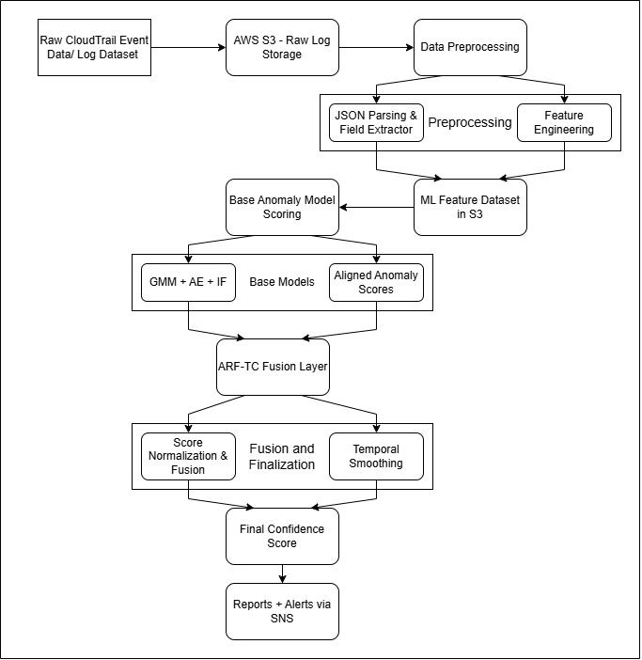
Proposed Methodology

Slide 10
Proposed
Solution
A multi-model anomaly detection framework built from Gaussian Mixture Models (GMM), Autoencoders (AE), and Isolation Forest (IF). These base models individually capture complementary behavioral patterns, while the final anomaly decision is produced by a novel fusion algorithm ARF-TC (Adaptive Reliability-Weighted Fusion with Temporal Consistency).

Slide 11
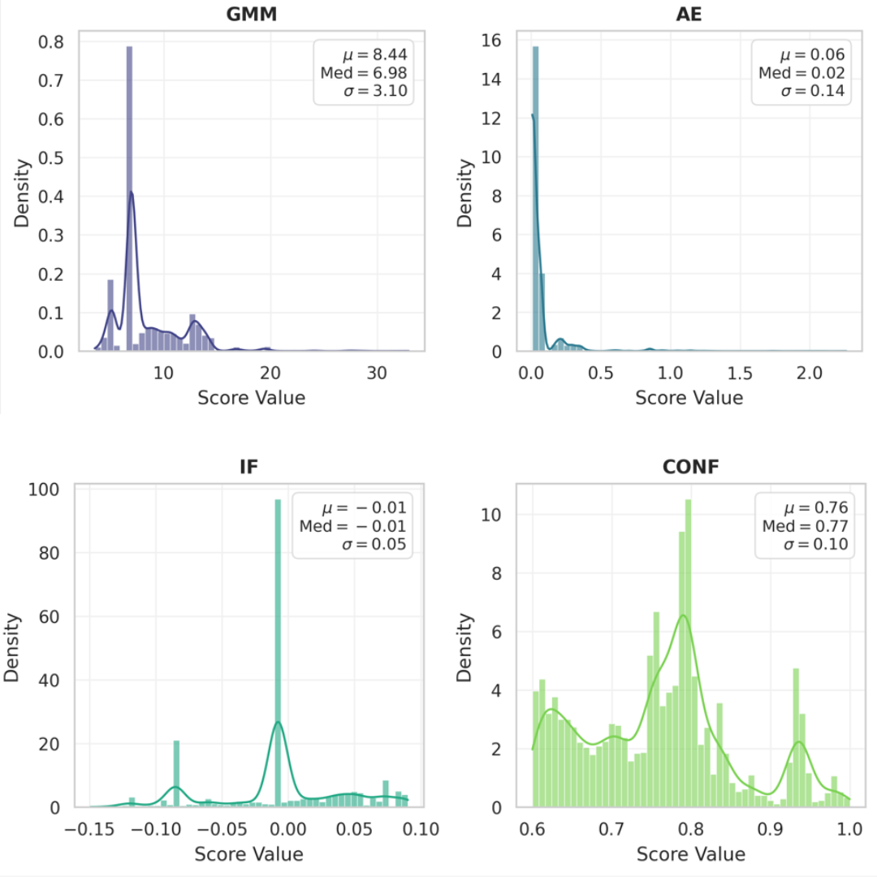
Results

Slide 12
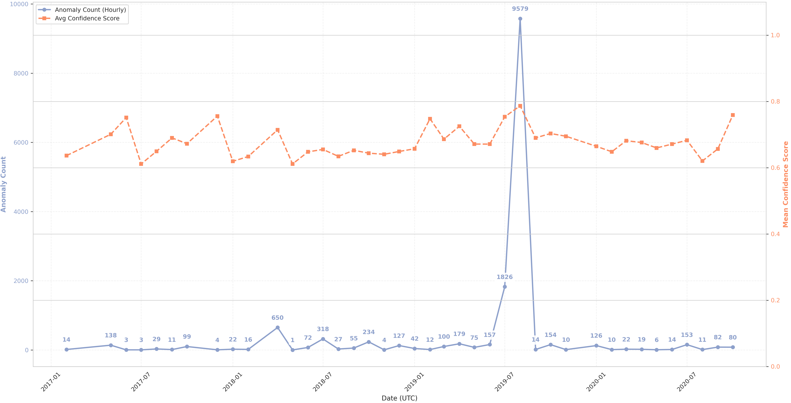
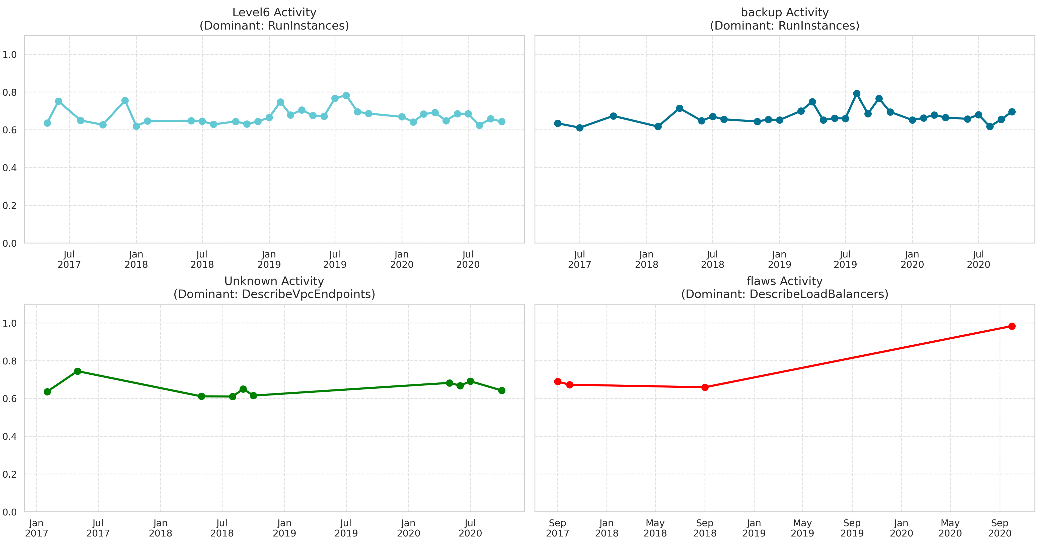
Results

Slide 13
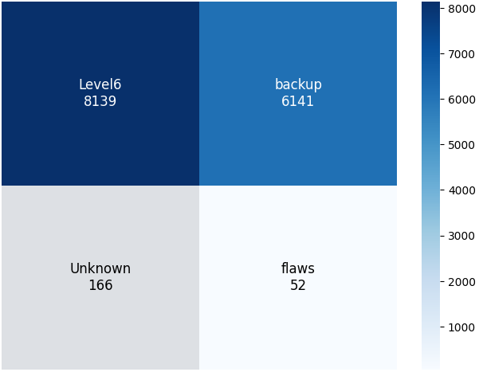
Results

Slide 14
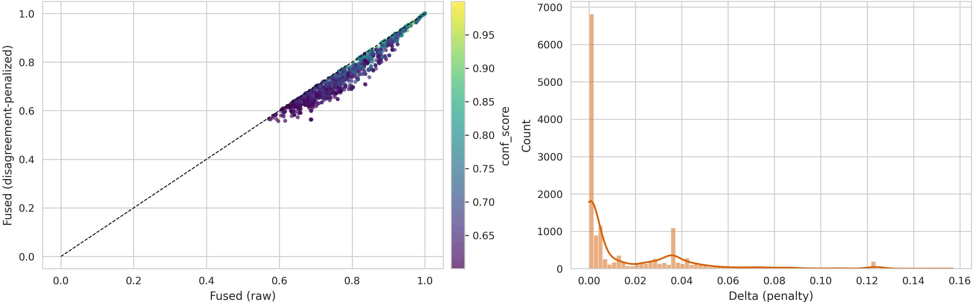
Results

Slide 15
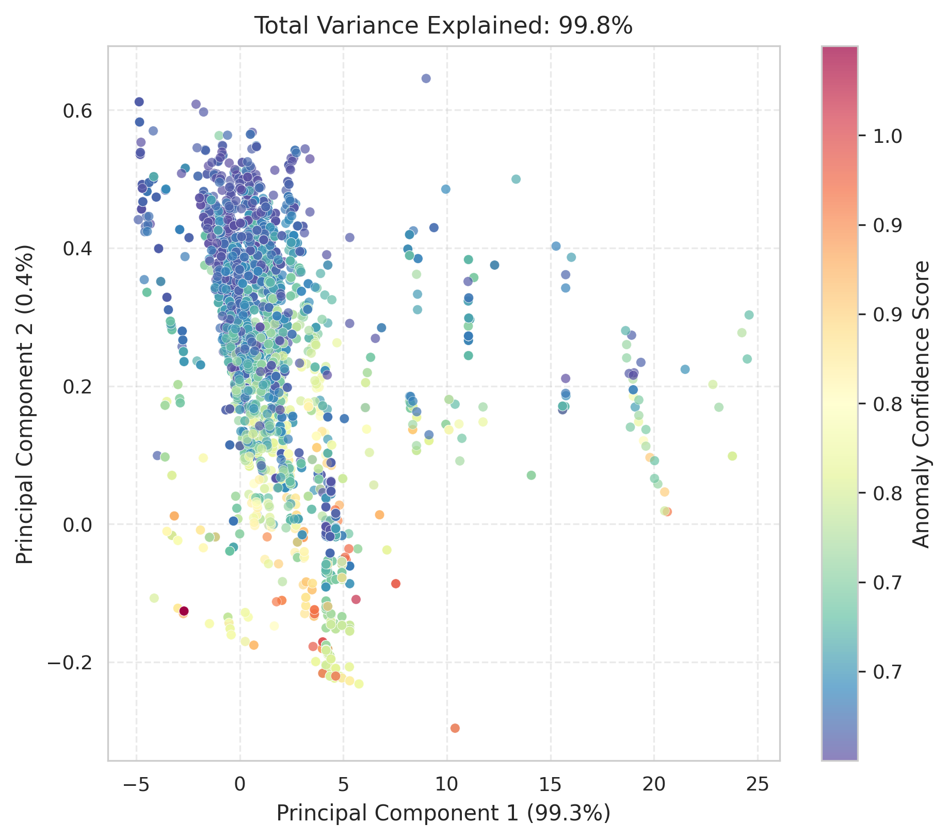
Results

Slide 16
Outcome
Research Paper Drafted
The research paper of this project is currently under active development. The core methodology, experimental results, and visual analyses have been drafted, and refinement of the fusion algorithm (ARF-TC) is ongoing. Several sections of the manuscript are being updated based on internal review and feedback to improve clarity, depth, and technical rigor. The work is progressing toward a complete, publication-ready version.

Slide 17
References
[12] M. Bahrololum and M. Khaleghi, "Anomaly Intrusion Detection SystemUsing Gaussian Mixture Model," 2008 Third International Conference onConvergence and Hybrid Information Technology, Busan, Korea (South),2008, pp. 1162-1167, doi: 10.1109/ICCIT.2008.17
[13] Y. Chen, J. Qian and V. Saligrama, "A new one-class SVM for anomalydetection," 2013 IEEE International Conference on Acoustics, Speech andSignal Processing, Vancouver, BC, Canada, 2013, pp. 3567-3571, doi:10.1109/ICASSP.2013.6638322
[14] Mishra, S., Chawla, M. (2019). A Comparative Study of Local OutlierFactor Algorithms for Outliers Detection in Data Streams. In: Abra-ham, A., Dutta, P., Mandal, J., Bhattacharya, A., Dutta, S. (eds) Emerg-ing Technologies in Data Mining and Information Security. Advancesin Intelligent Systems and Computing, vol 813. Springer, Singapore.https://doi.org/10.1007/978-981-13-1498-8_31
[15] K. Zhang, X. Kang and S. Li, "Isolation Forest for Anomaly Detectionin Hyperspectral Images," IGARSS 2019 - 2019 IEEE International Geo-science and Remote Sensing Symposium, Yokohama, Japan, 2019, pp.437- 440, doi: 10.1109/IGARSS.2019.8899812.
[16] G. Zhu, H. Zhao, H. Liu and H. Sun, "A Novel LSTM-GAN Algorithmfor Time Series Anomaly Detection," 2019 Prognostics and System HealthManagement Conference (PHM-Qingdao), Qingdao, China, 2019, pp. 1-6,doi: 10.1109/PHM-Qingdao46334.2019.8942842.
[17] Farzad, Amir Gulliver, T. Aaron. (2020). Unsupervised log messageanomaly detection. ICT Express. 6. 229-237. 10.1016/j.icte.2020.06.003

Slide 18
Thank You

